Slide 1
A2
VHDL Combinational Logic Design
陳慶瀚
國立中央大學資工系
2015年4月22日

Slide 2
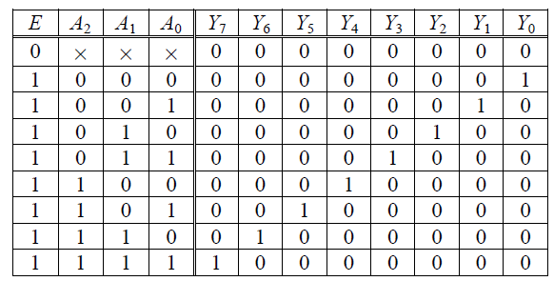
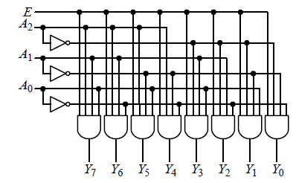
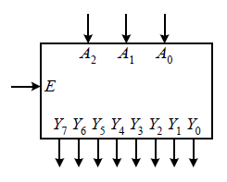
Decoder

Slide 3
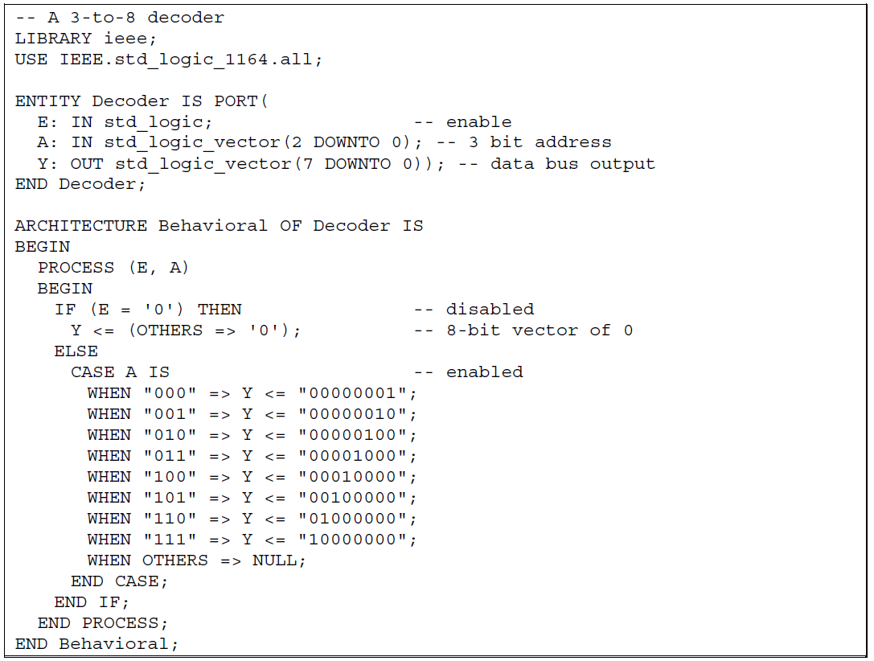
Decoder

Slide 4
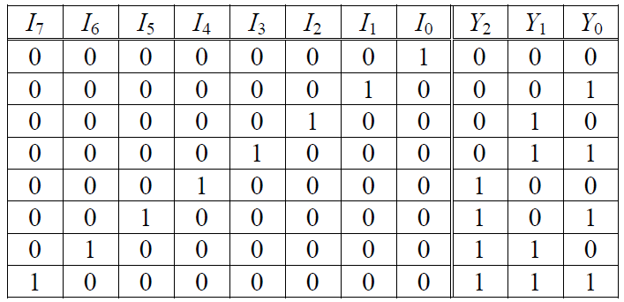
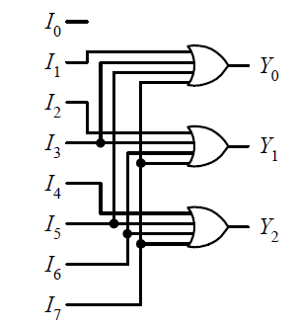
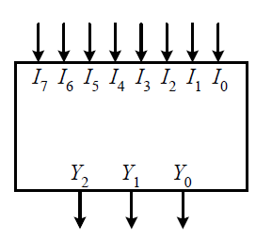
Encoder

Slide 5
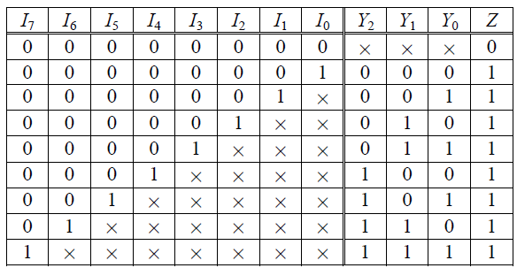
Priority Encoder

Slide 6
8-3 Priority Encoder
ENTITY ENCODER8_3 IS
PORT ( ENABLE: IN STD_LOGIC;
D_IN: IN STD_LOGIC_VECTOR(7 DOWNTO 0);
D_OUT: OUT STD_LOGIC_VECTOR(2 DOWNTO 0) );
END ENCODER8_3;
ARCHITECTURE ENCODER_ARCH OF ENCODER8_3 IS
BEGIN
PROCESS(ENABLE,D_IN)
BEGIN
IF ( ENABLE = '1') THEN
D_OUT <= "000";
ELSE
CASE D_IN IS
WHEN "00000001" => D_OUT <= "000";
WHEN "0000001X " => D_OUT <= "001";
WHEN "000001XX " => D_OUT <= "010";
WHEN "00001XXX " => D_OUT <= "011";
WHEN "0001XXXX " => D_OUT <= "100";
WHEN "001XXXXX " => D_OUT <= "101";
WHEN "01XXXXXX" => D_OUT <= "110";
WHEN "1XXXXXXX" => D_OUT <= "111";
WHEN OTHERS => NULL;
END CASE;
END IF;
END PROCESS;
END ENCODER_ARCH;

Slide 7
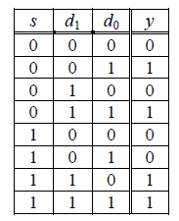
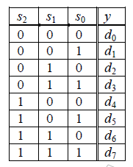

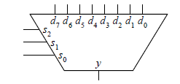
Multiplexer

Slide 8
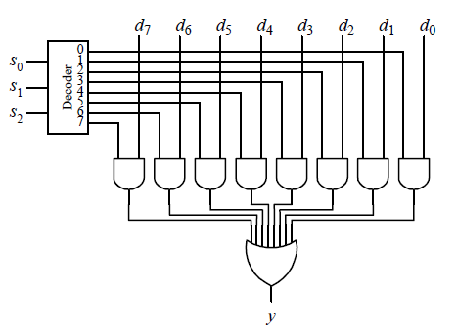
8-to-1 Multiplexer Implementation
3-to-8 decoder
+ AND/OR gate

Slide 9
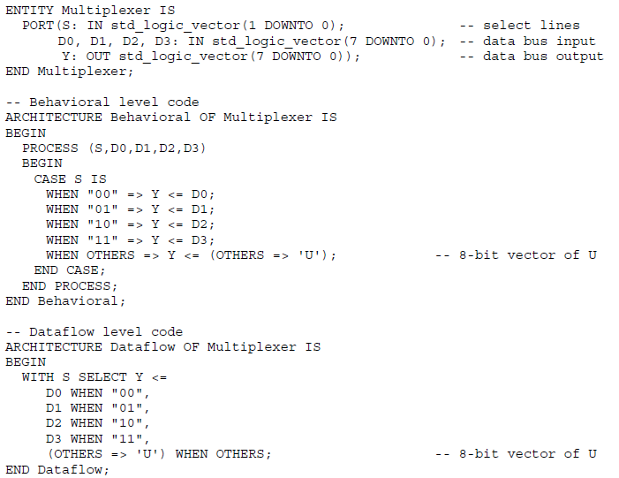
VHDL: 8-to-1 Multiplexer

Slide 10
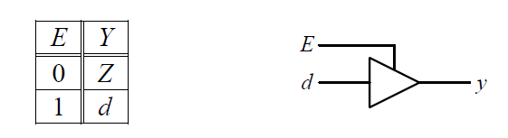
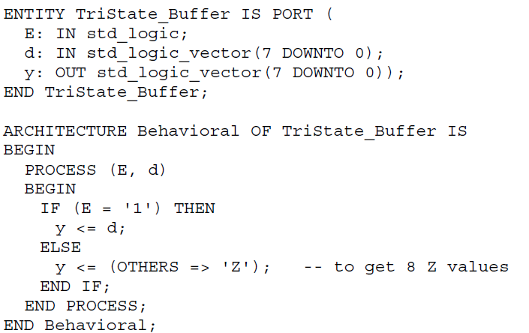
Tri-state Buffer

Slide 11
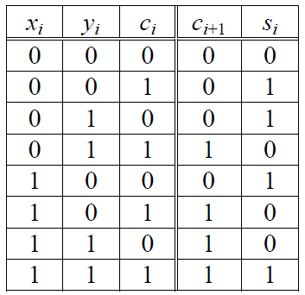
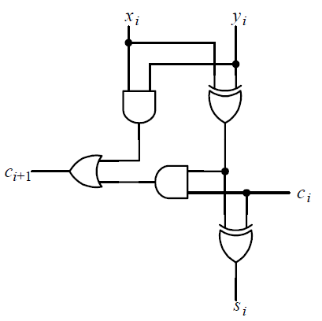
1-bit full adder

Slide 12
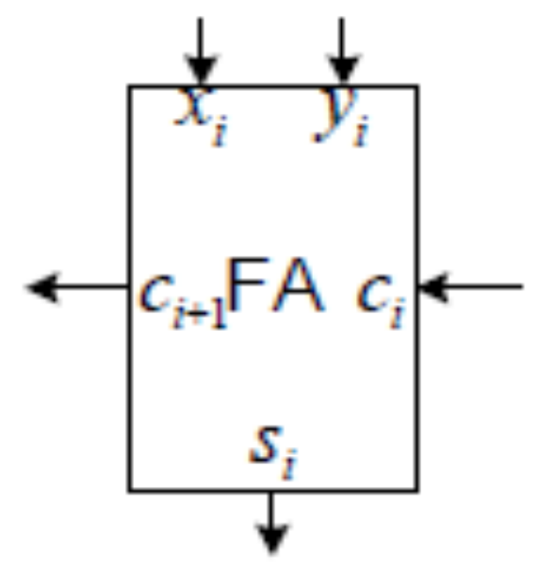
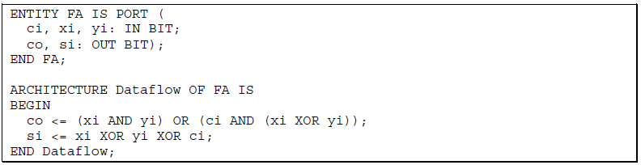
1-bit full adder

Slide 13
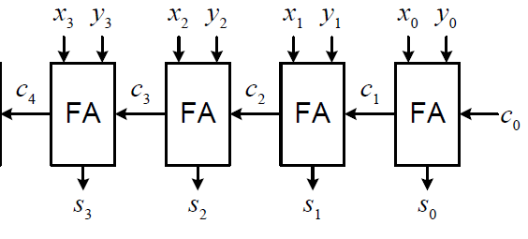
VHDL：4-bit ripple-carry adder

Slide 14
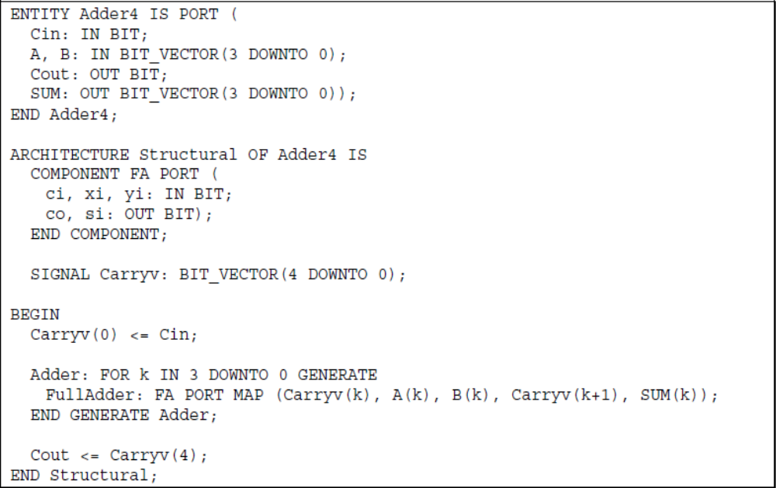
VHDL：4-bit ripple-carry adder(cont.)

Slide 15
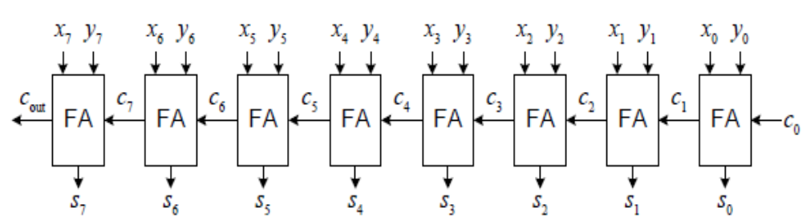
ex：8-bit ripple-carry adder

Slide 16



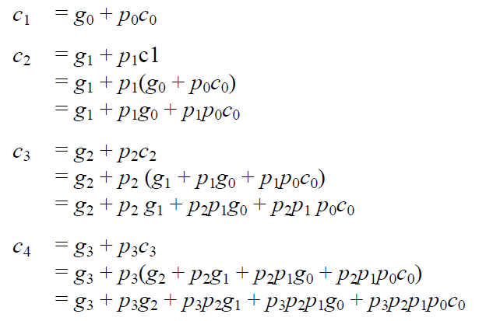
Carry-Lookahead Adder

Slide 17
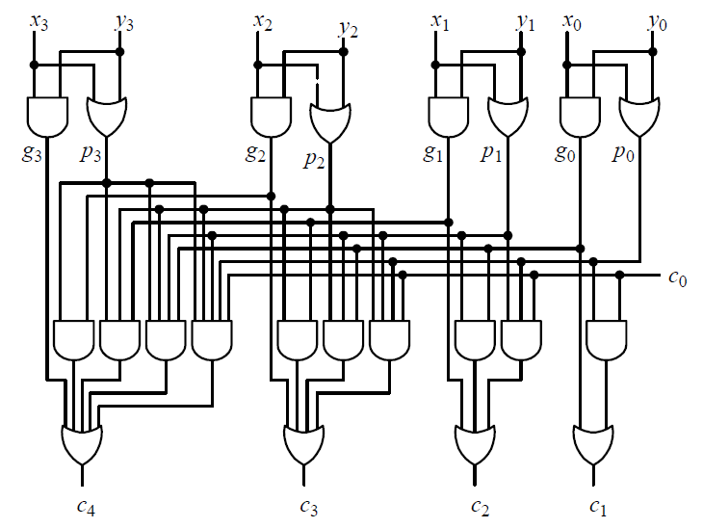
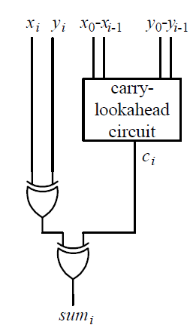
Carry-Lookahead Adder

Slide 18
VHDL: 8-bit Carry-Lookahead Adder
ENTITY c_l_addr IS
PORT
(
x_in : IN STD_LOGIC_VECTOR(7 DOWNTO 0);
y_in : IN STD_LOGIC_VECTOR(7 DOWNTO 0);
carry_in : IN STD_LOGIC;
sum : OUT STD_LOGIC_VECTOR(7 DOWNTO 0);
carry_out : OUT STD_LOGIC
);
END c_l_addr;
ARCHITECTURE behavioral OF c_l_addr IS
SIGNAL h_sum : STD_LOGIC_VECTOR(7 DOWNTO 0);
SIGNAL carry_generate : STD_LOGIC_VECTOR(7 DOWNTO 0);
SIGNAL carry_propagate : STD_LOGIC_VECTOR(7 DOWNTO 0);
SIGNAL carry_in_internal : STD_LOGIC_VECTOR(7 DOWNTO 1);
BEGIN
h_sum <= x_in XOR y_in;
carry_generate <= x_in AND y_in;
carry_propagate <= x_in OR y_in;
PROCESS (carry_generate,carry_propagate,carry_in_internal)
BEGIN
carry_in_internal(1) <= carry_generate(0) OR (carry_propagate(0) AND carry_in);
inst: FOR i IN 1 TO 6 LOOP
carry_in_internal(i+1) <= carry_generate(i) OR (carry_propagate(i) AND carry_in_internal(i));
END LOOP;
carry_out <= carry_generate(7) OR (carry_propagate(7) AND carry_in_internal(7));
END PROCESS;
sum(0) <= h_sum(0) XOR carry_in;
sum(7 DOWNTO 1) <= h_sum(7 DOWNTO 1) XOR carry_in_internal(7 DOWNTO 1);
END behavioral;

Slide 19
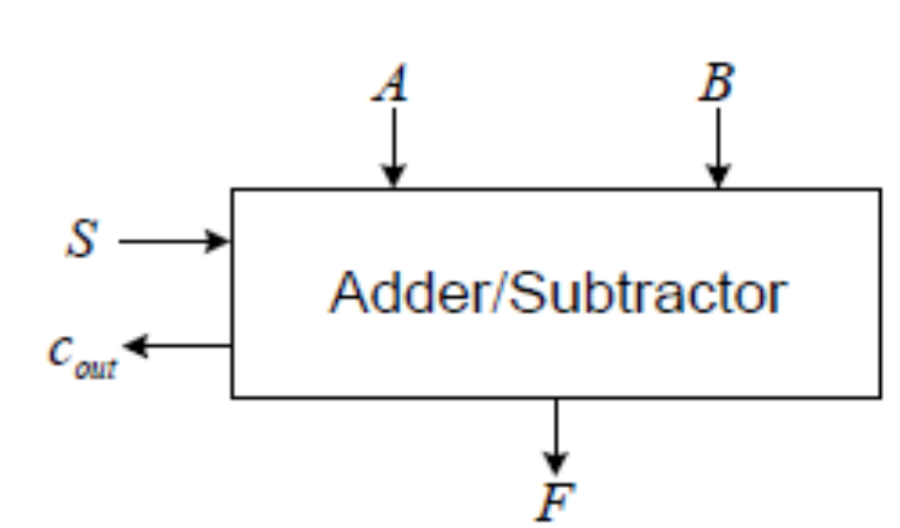
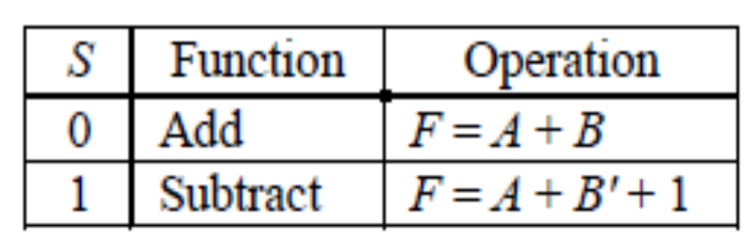
VHDL：8-bit adder / subtractor

Slide 20
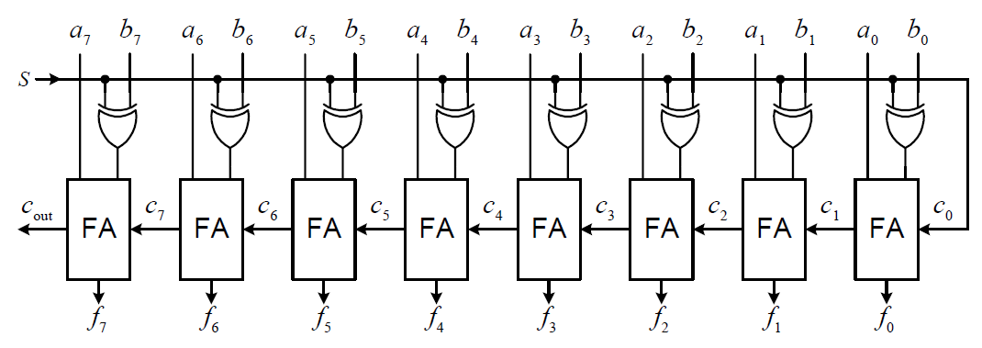
VHDL：8-bit adder / subtractor

Slide 21
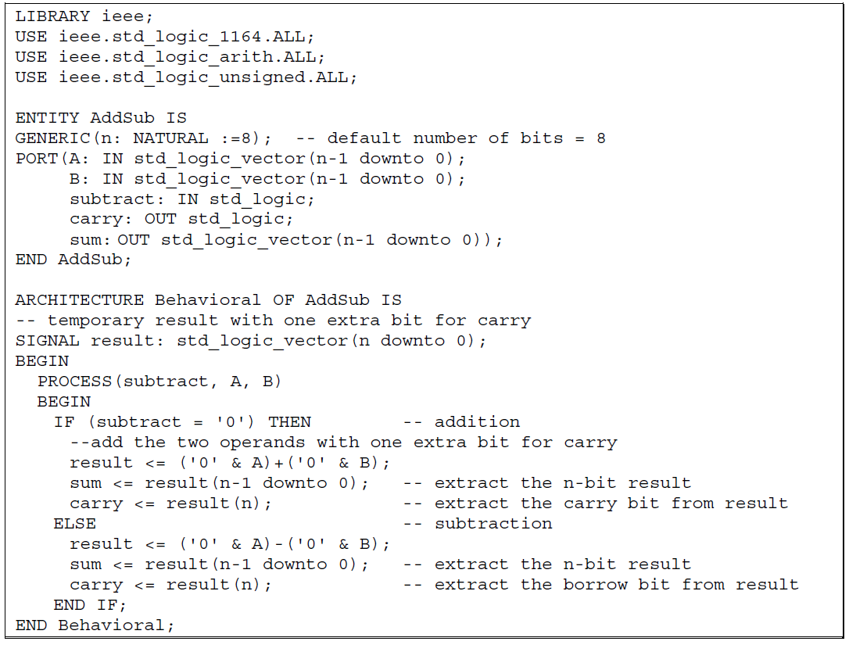
VHDL：8-bit adder / subtractor

Slide 22
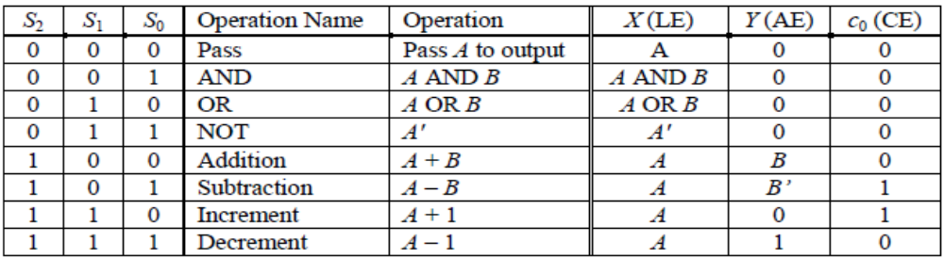
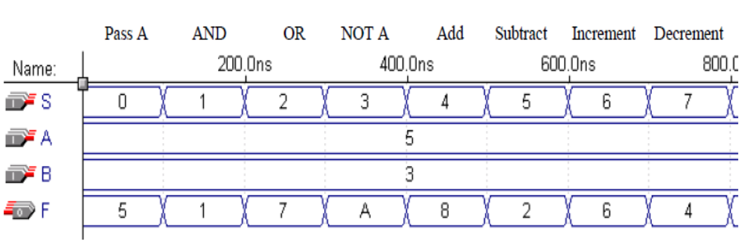
4-bit ALU
提示：
--使用process
--使用CASE-WHEN語法
請模擬出以下波形：

Slide 23
4-bit ALU
提示：
--使用process
--使用CASE-WHEN語法
請模擬出以下波形：

Slide 24
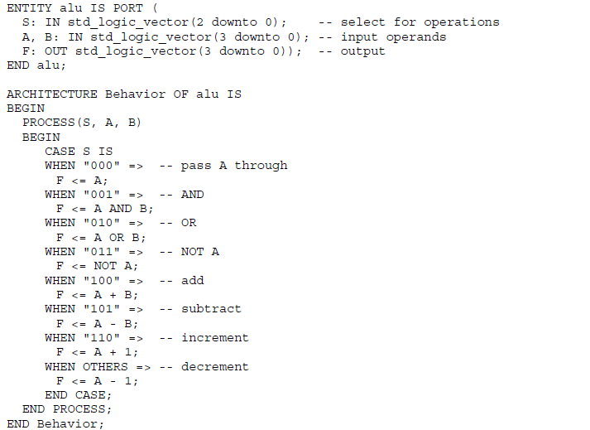
VHDL : 4-bit ALU

